Slide 1
Universal Access to Adolescent Sexual and Reproductive Health, HFLE and CSE – Successes and Untapped Opportunities
-Youth Perspective
Presented by: Mr. Dennis Glasgow

Slide 2
“Universal Access to Adolescent SRH information and services.”
-How we feel
What is key here as well, is that we zoom into the “universal”.
That means, we need to also talk about equal AND equitable access to SRH. What a 15 year old, lighter skinned, straighter hair, male, from a middle or upper class family in the capital city- what he has access to. So should indigenous girls his age, living in what is perceived to be poorer conditions in the hinterland communities, be able to also access.
When we ask for universal access to ASRH, we are essentially asking for all young people; especially adolescents to have access to health care services; especially those relating to their sexual reproductive health.

Slide 3
Where do we start, in addressing access to services?
“I am of the belief that if you want to change the culture of a people, if you want to change beliefs and attitudes then you start first by acknowledging the issues and that there is sufficient evidence through data to illustrate why we need access. As a region, we have some of the highest per capita rates of teen pregnancy, & there is alarming data that shows the region’s young people are affected by and are newly infected by HIV and other STIs.”
1

Slide 4
Where do we start, in addressing access to services?
We need to change perceptions about how we address adolescents. These are not children, and neither are they adults so we can not talk about having existing regulations for children and think that adequately covers the peculiarity of this period .
We need to have legislation that speaks not only to the education aspect and ensuring young people have access to information about their SRH but we need to call for policies, strategies, and legislation that explicitly speaks to our access to services.
2
3

Slide 5
Where do we start, in addressing access to services?
We need to talk about physical access. Young people are not homogeneous, we represent a cross sections of youth living with disabilities, indigenous youth, poor youth, LGBT youth, youth in state care, etc. How do ALL of us access services if we cannot physically meet or enter facilities?
We need to also talk about the involvement of parents and communities in ASRH, and this also refers to whether or not the community has a health facility and how exactly can they access these services if there are no facilities in the community.
4
5

Slide 6
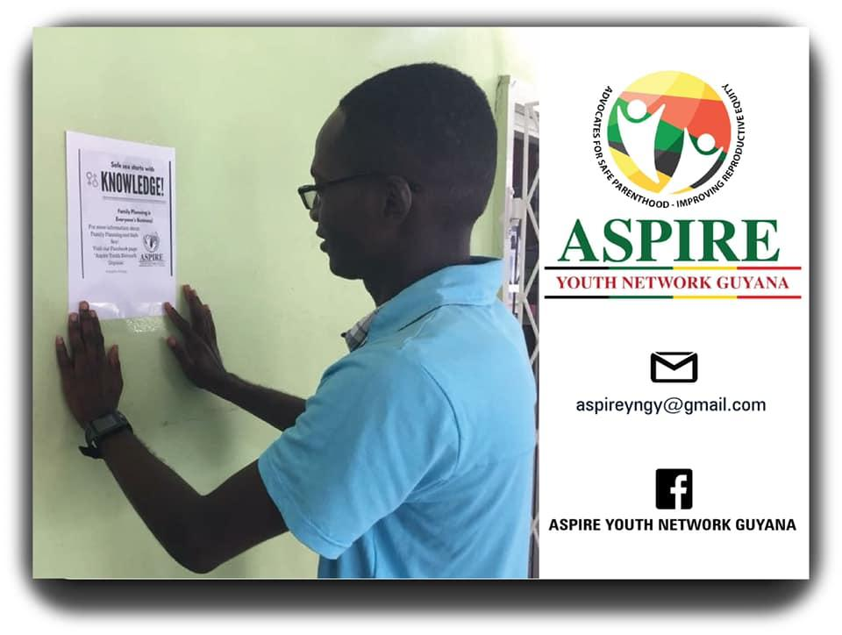
There are various ways to have the community support for young people. We start by sharing information with the influencers in the community about these issues and ask that they encourage their children or young people to take their health seriously and point them in the direction to access these services.
A young Guyanese volunteer, placing a poster about condomizing at a local “Rum shop”

Slide 7
Where do we start, in addressing access to services?
The other thing we need to talk about in conversations, is who are the people providing young people with information and services about their SRH. As such, we need to talk about the training of teachers to deliver information and the training of all workers at health care facilities, including the guards and ancillary staff. They need to understand confidentiality, and they need to be able to provide quality services to all young people, even vulnerable populations.
6

Slide 8
HFLE and CSE
Thoughts and Suggestions :

Slide 9
Putting HFLE into Context.
Health and Family Life Education (HFLE) has it’s genesis in 1995. That is 24 years ago and still the region has challenges in delivery.
HFLE, focuses on self and interpersonal relationships, sexuality and sexual health, eating and fitness, and managing the environment .
The component that focuses on “Sex and Sexuality” is the most contentious and has been the source of most of the debates .

Slide 10
Important Points to Note about HFLE in the Caribbean.
HFLE should be delivered to IN- & OUT-of-school youth.
In some cases, HFLE is still not timetabled subject so many youth in school do not have access to it.
Out-of-school youth in some places do not have any access to it all all.
HFLE is Not Timetabled
In some countries, there is no time specifically dedicated to the delivery of HFLE so by extension, institutions do not see the importance of its delivery.
Lack of Strategic Partnerships that aid in the delivery of HFLE.
This is important, since these partnerships can ensure young people in schools without HFLE teachers, still have the requisite information and life skills development.

Slide 11
Important Points to Note about HFLE in the Caribbean.
HFLE is mandated from ages 10 to 14, in some cases.
An HFLE Curriculum exists, specifically for these ages. However, rigorous HFLE is not present from nursery to secondary school. Usually, the curricula ends in the third year of high school.
HFLE is Not Examinable.
There is an argument as to whether HFLE will be taken more seriously if it is examinable, or if it will be too much pressure for the young people who are already being tested in 10 and more subjects.
Lack of Trained Teachers to Deliver HFLE.
Lack of specialisation at a teachers’ training level, has led to a lack of trained educators to deliver such a sensitive subject as HFLE.

Slide 12
COMPREHENSIVE
SEXUALI TY EDUCATION (CSE)
CSE IS NOT HFLE
While Guyana and Jamaica have made notable reviews to include more CSE in the HFLE curriculum; the two are not the same.
CSE IS (UNESCO)
Comprehensive sexuality education (CSE) is a curriculum-based process of teaching and learning about the cognitive, emotional, physical and social aspects of sexuality. It aims to equip children and young people with knowledge, skills, attitudes and values that will empower them to: realize their health, well-being and dignity; develop respectful social and sexual relationships; consider how their choices affect their own well-being and that of others; and, understand and ensure the protection of their rights throughout their lives.

Slide 13
What are some of the Untapped Opportunities in HFLE and CSE?

Slide 14
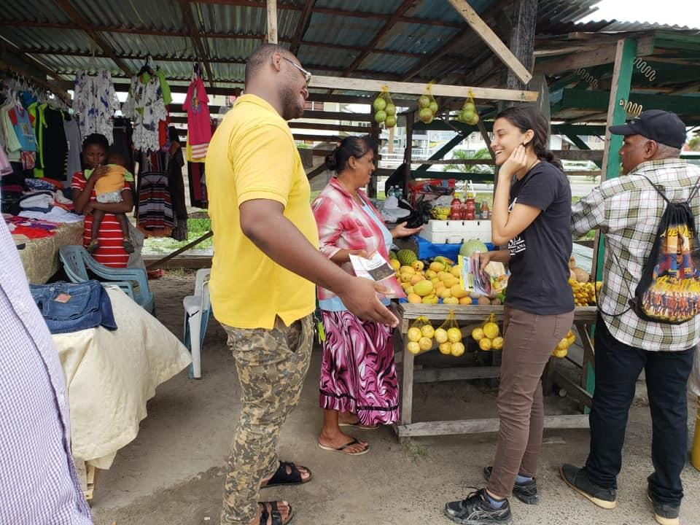
What can be done?
Integrate key CSE components into HFLE
Collaborate with Civil Society groups that address CSE and Sexual Reproductive Health and Rights (SRHR) to deliver HFLE to IN- and OUT-of-school youth, who lack facilitators or teachers.
Ensure that youth SRHR activists and advocates are a part of the Cross Sectoral team that designs and reviews HFLE curriculum.

Slide 15
What can be done?
Utilize young people (youth with exposure) in the Monitoring and Evaluation of HFLE. This could be beneficial since young people generally share more with their peers.
Use public outbursts of ignorance to various SRHR issues, as entry points to change narratives and illustrate the importance of HFLE.eg, Domestic Violence Videos, School Pornography, etc.

Slide 16
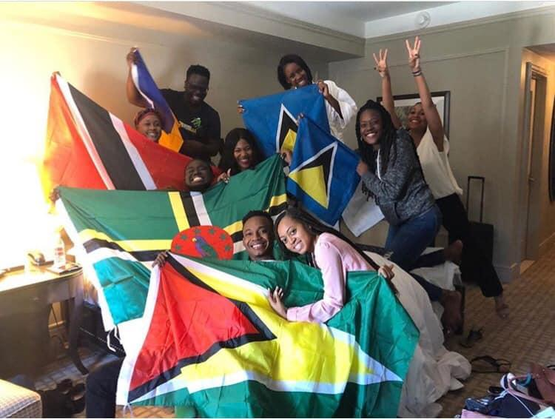
What can be done?
Partner with regional and international partners that are addressing CSE and HFLE. They have the technical guidance and support, and some funding to address this.
Reach out to other countries for best practices.
Consider reaching out to Universities to offer HFLE/Life Skills courses to ALL students.

Slide 17
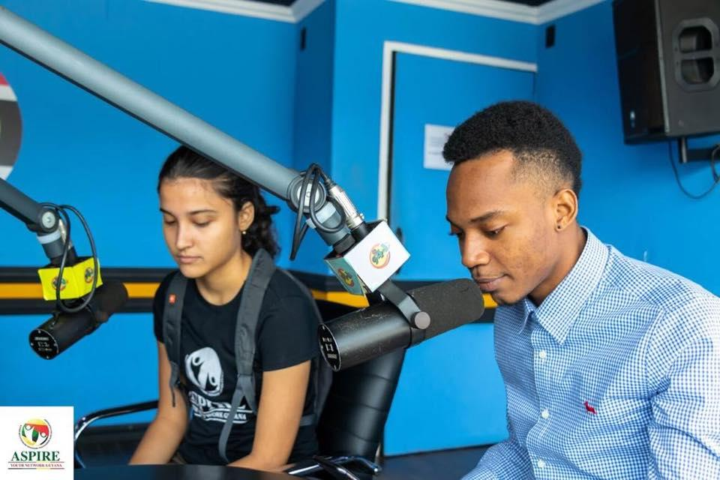
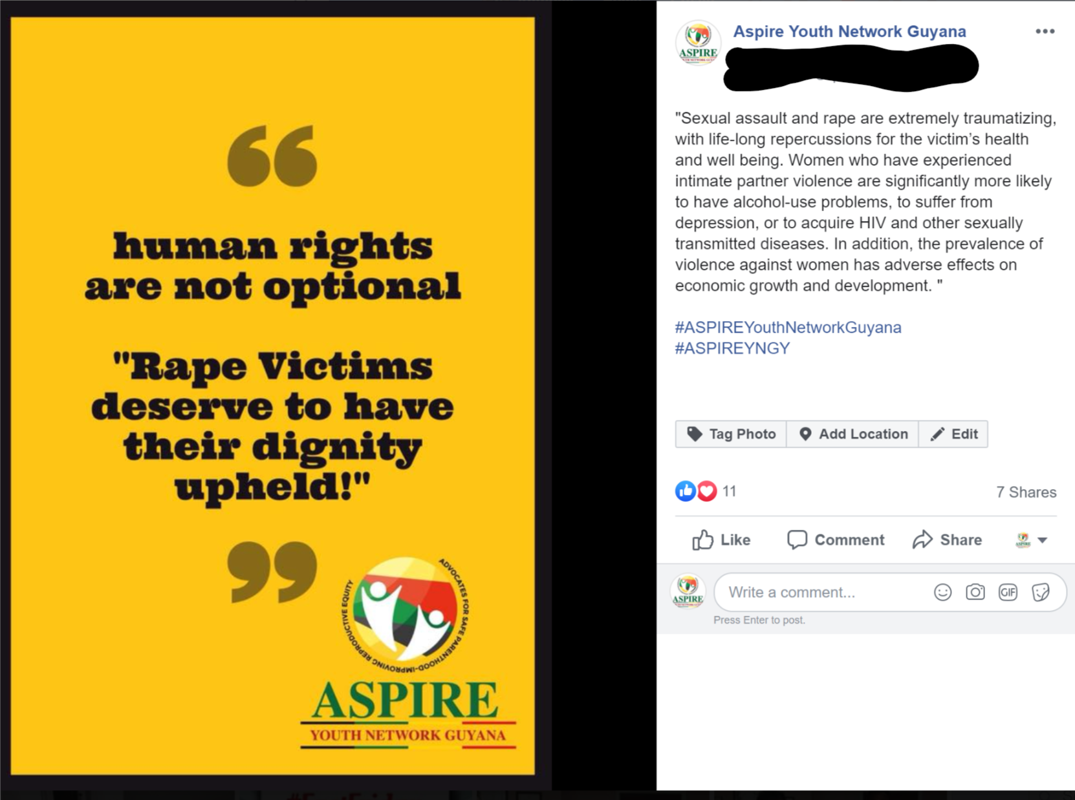
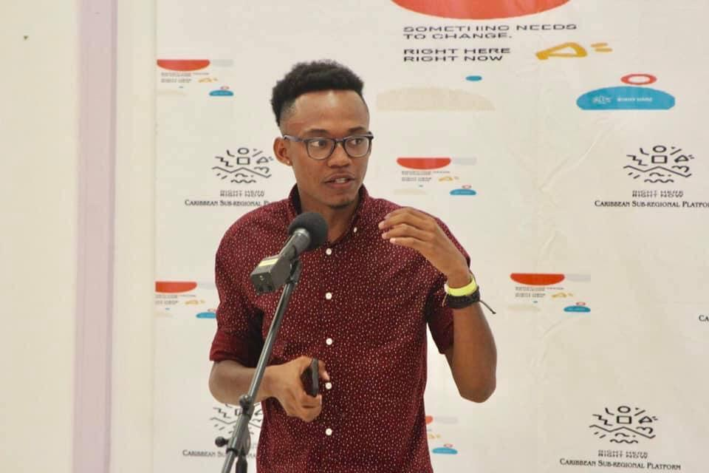
What can be done?
Meet young people where we are at! Learn to use social media and traditional media to share CSE and HFLE content with us.

Slide 18
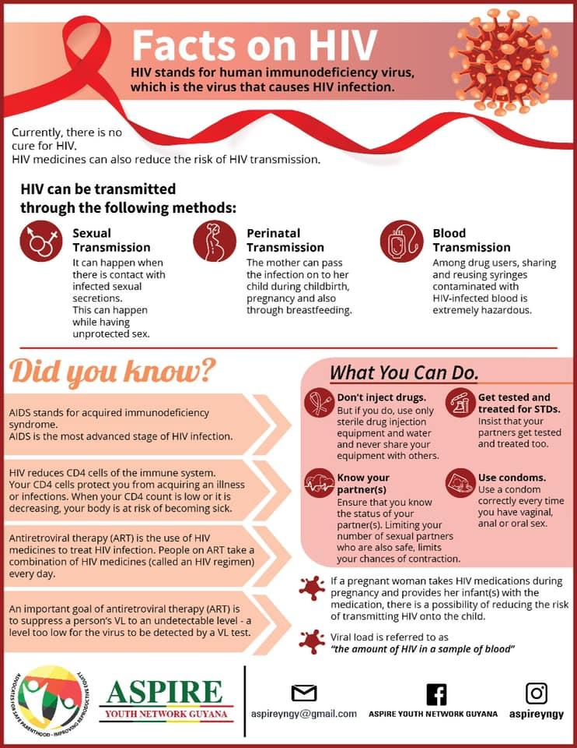
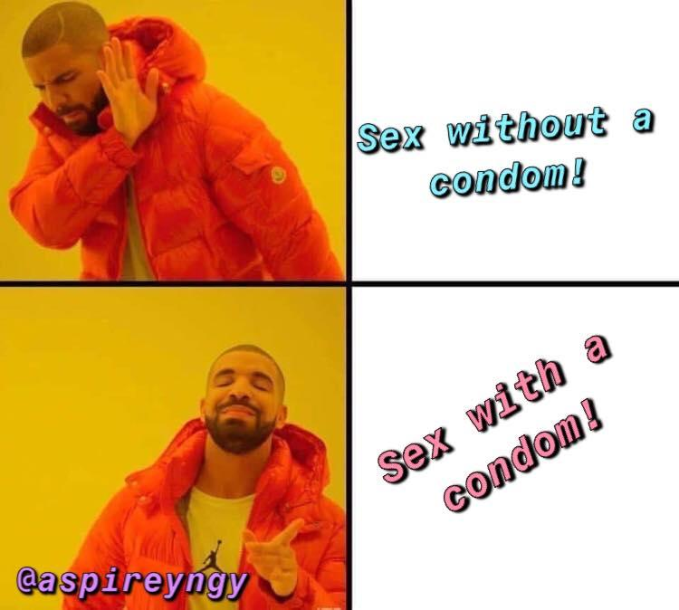
EXAMPLES OF SOCIAL MEDIA POSTS FOR YOUTH

Slide 19
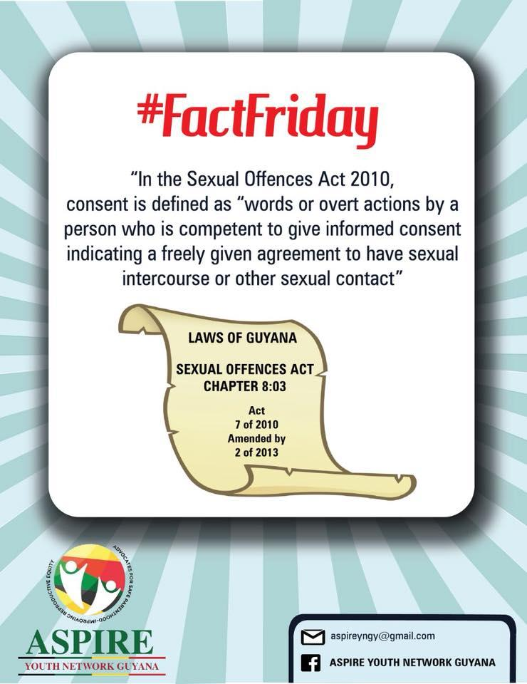
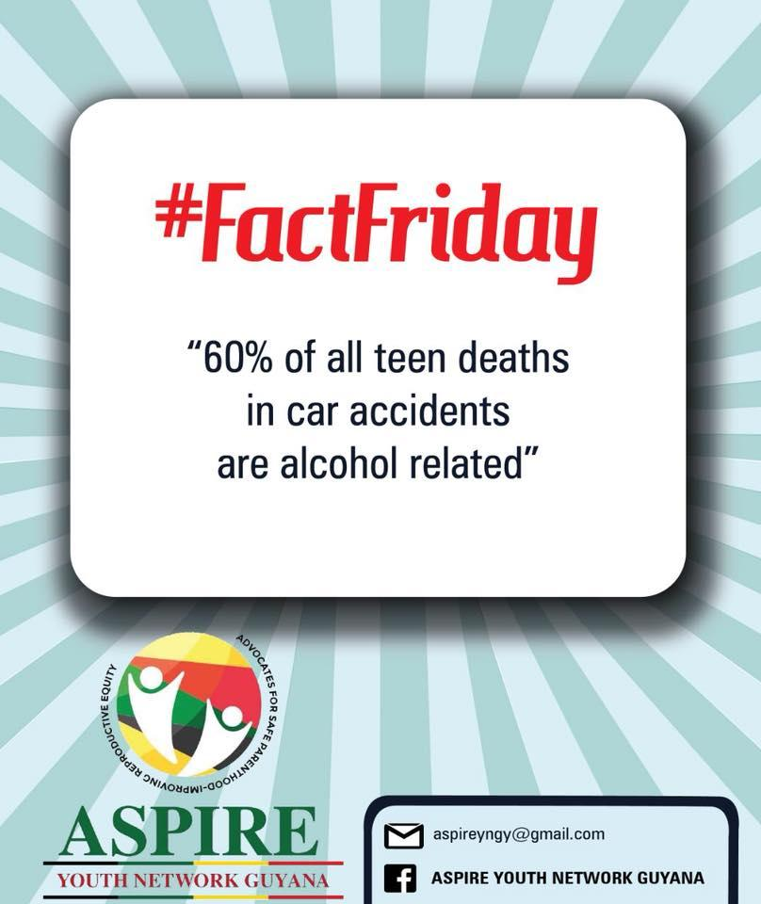
EXAMPLES OF SOCIAL MEDIA POSTS FOR YOUTH

Slide 20
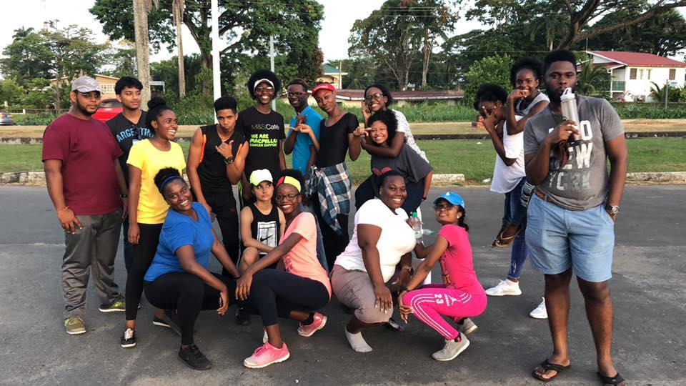
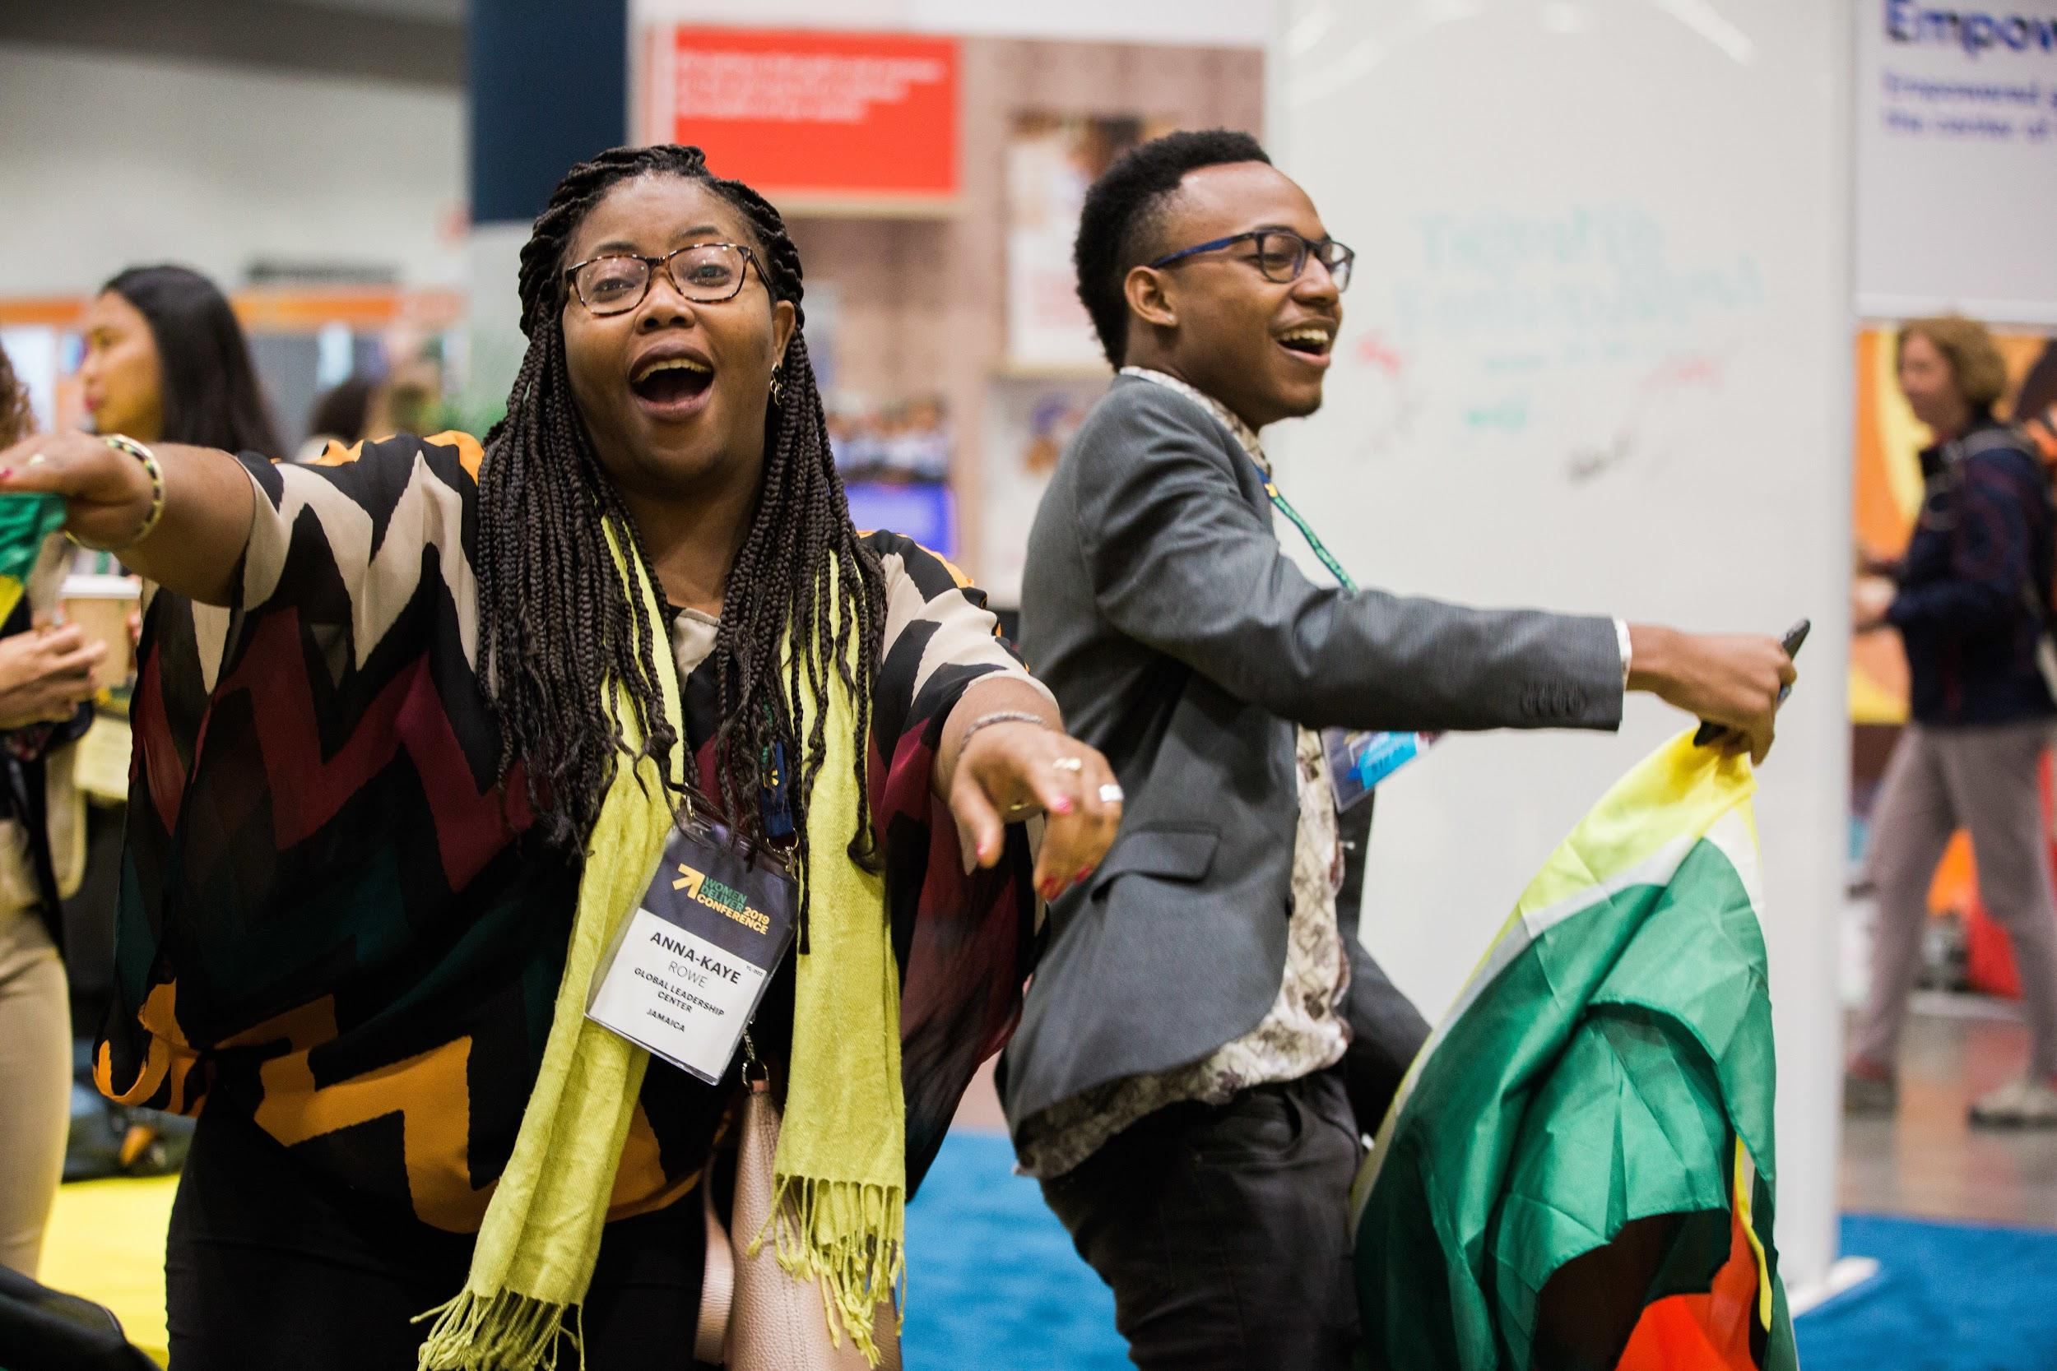
A picture is worth a thousand words.
REACH US=TEACH US
The Power of Modern Media!
IT CONNECTS THE REGION’s YOUTH!

Slide 21
Thanks!
Any questions?
You can reach me at: dennisglasgow82@yahoo.com or dennis@youthcoalition.org

